Slide 1
When Culture Is Challenged by Art: Pro-Life Responses in the Art of T. Gerhardt Smith to Cultural Aggression Against the Vulnerable PowerPoint to Accompany Presentation for the Society of Catholic Social Scientists Franciscan University of Steubenville 25 October 2019 Dr. Jeff Koloze DeVry University DrJeffKoloze@att.net 216-262-3511

Slide 2
Structure of Presentation
Principles of art aesthetics from a Catholic perspective, consistent with St. John Paul II’s Letter to Artists (1999)
Smith’s paintings on the three life issues of abortion, infanticide, and euthanasia
Evaluation of paintings’ compliance with Letter to Artists
Questions and answers
T. Gerhardt Smith, image from exhibition handout

Slide 3
Iconic Images in Popular Culture
Kent State, 4 May 1970. Image credit: Wikipedia
Gloria Swanson in her iconic role as Norma Desmond in Sunset Boulevard (1950). Image credit: clip art.

Slide 4
Pro-Life Catalog of Iconic Images
American Liberty Upside Down. Image source credit: Strobel, The Free Lance-Star.
Photo credit: author’s copy

Slide 5
St. John Paul II’s Letter to Artists (1999)
“new ‘epiphanies’ of beauty”
contemporary artists “who are passionately dedicated to the search for” new manifestations of beauty
“The link between good and beautiful stirs fruitful reflection. In a certain sense, beauty is the visible form of the good, just as the good is the metaphysical condition of beauty. This was well understood by the Greeks who, by fusing the two concepts, coined a term which embraces both: kalokagathía, or beauty-goodness. On this point Plato writes: ‘The power of the Good has taken refuge in the nature of the Beautiful.’”

Slide 6
St. John Paul II’s Letter to Artists (1999)
“Those who perceive in themselves this kind of divine spark which is the artistic vocation—as poet, writer, sculptor, architect, musician, actor and so on—feel at the same time the obligation not to waste this talent but to develop it, in order to put it at the service of their neighbour and of humanity as a whole. [….] Every genuine art form in its own way is a path to the inmost reality of man and of the world. It is therefore a wholly valid approach to the realm of faith, which gives human experience its ultimate meaning.”
“It is true nevertheless that, in the modern era, alongside this Christian humanism which has continued to produce important works of culture and art, another kind of humanism, marked by the absence of God and often by opposition to God, has gradually asserted itself.”

Slide 7
St. John Paul II’s Letter to Artists (1999)
“Even when they explore the darkest depths of the soul or the most unsettling aspects of evil, artists give voice in a way to the universal desire for redemption.”
“Art must make perceptible, and as far as possible attractive, the world of the spirit, of the invisible, of God.”
“Artists are constantly in search of the hidden meaning of things, and their torment is to succeed in expressing the world of the ineffable."
“People of today and tomorrow need this enthusiasm if they are to meet and master the crucial challenges which stand before us.”

Slide 8
Artist’s Comments on Sorrow Without Tears
Source credit: Private collection of Dr. Samuel Nigro

Slide 9
Sorrow Without Tears: Post-Abortion Syndrome
Source credit: Private collection of Dr. Samuel Nigro

Slide 10
Zelanski and Fisher (2010)
“According to physiological research with the effects of colored lights, red wavelengths stimulate the heart, the circulation, and the adrenal glands, increasing strength and stamina. […] Yellow light is stimulating for the brain and nervous system, bringing mental alertness and activating the nerves in the muscles. Green lights affect the heart, balance the circulation, and promote relaxation and healing of disorders such as colds, hay fever, and liver problems. Blue wavelengths affect the throat and thyroid gland, bring cooling and soothing effects, and lower blood pressure.” (41)
“Psychological literature is full of attempts to determine how specific colors affect human health and behavior and how best to put the results into effect. […] Bright colors, particularly warm hues, seem conducive to activity and mental alertness and are therefore increasingly being used in schools. Cooler, duller hues, on the other hand, tend to sedate.” (42)

Slide 11
Zelanski and Fisher (2010)
Children “are affected by color energies in ways that transcend seeing. One hypothesis is that neurotransmitters in the eye transmit information about light to the brain even in the absence of sight, and that this information releases a hormone in the hypothalamus that has numerous effects on our moods, mental clarity, and energy level. [Furthermore,] colors that seem to increase blood pressure and pulse and respiration rates are, in order of increasing effect, red, orange, and yellow.” (42)
Red “associated with the color of blood, as well as with fire, warmth, brightness, and stimulation” and anger; and gray with “independence, separation, loneliness, [and] self-criticism” (43-48)
“The actual emotional effect of a specific color in an artwork depends partly on its surroundings and partly on the ideas expressed by the work as a whole. To be surrounded by blue […] is quite different from seeing a small area of blue in a larger color context.” (49)

Slide 12
Sorrow Without Tears: Post-Abortion Syndrome
Source credit: Private collection of Dr. Samuel Nigro

Slide 13
Femicidal National Organization Woman’s Planned Parentless Selfish Movement
Source credit: Private collection of Dr. Samuel Nigro

Slide 14
Killer Caduceus
Source credit: Private collection of Dr. Samuel Nigro

Slide 15
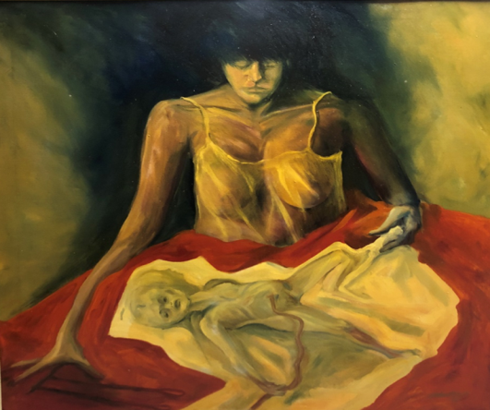
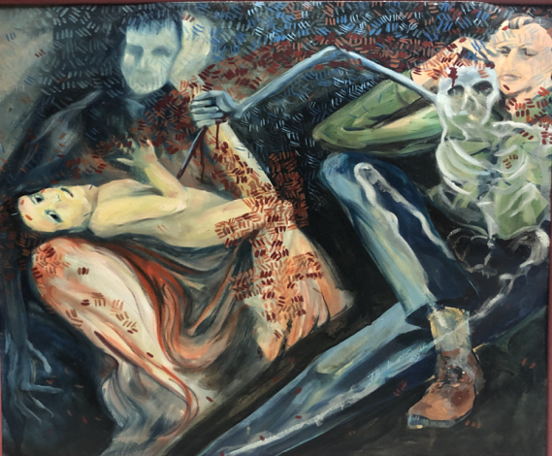
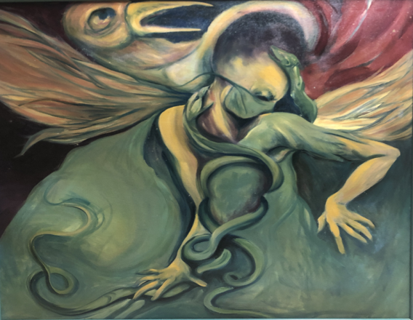
Source credits: Private collection of Dr. Samuel Nigro

Slide 16
Works Cited

