Slide 1
Technological Aspects of a Pro-Life Bibliography PowerPoint to Accompany LifeTech Conference Presentation University of Dayton 24 September 2016 Dr. Jeff Koloze DrJeffKoloze@att.net 216-262-3511

Slide 2
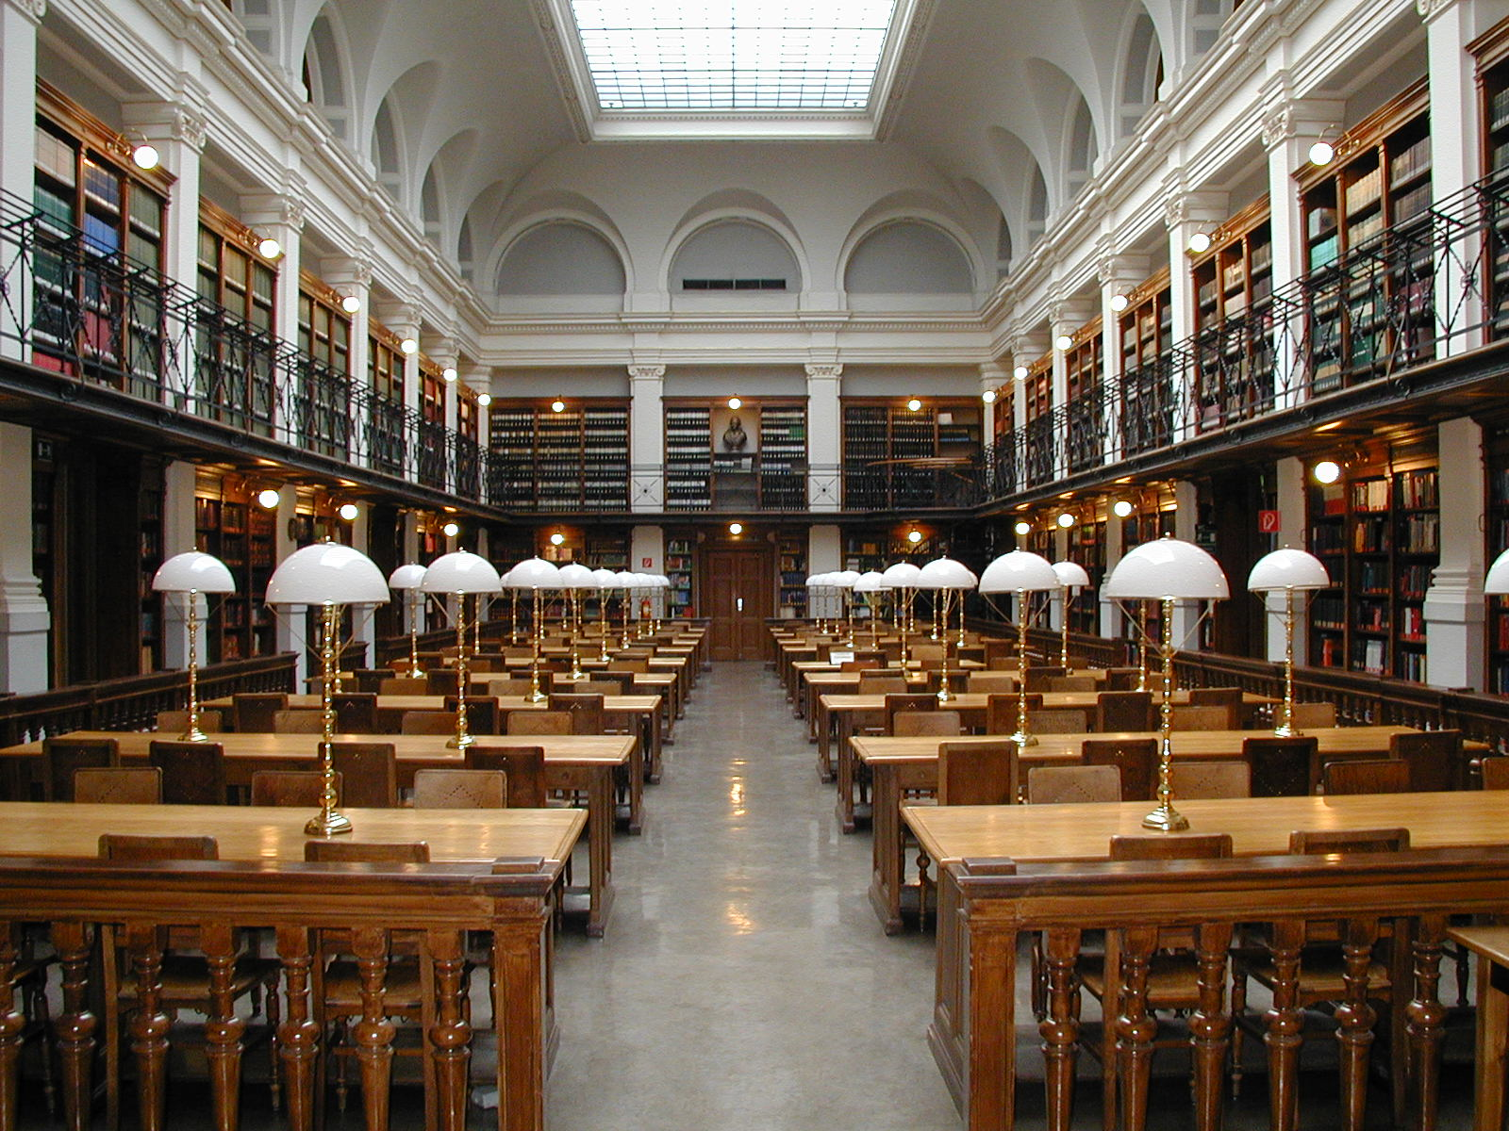
Presentation Outline
Background of the pro-life bibliography and website
Establishment of the LifeLit Institute website
Template language on the site
Specific ethical issues
Future activity and projects
Audience comments

Slide 3
Nellie Gray (1924-2012)
Photo credit: Lifenews.com

Slide 4
Dr. Jack Willke (1925-2015) Barbara Willke (1923-2013)
Photo credit: Lifenews.com

Slide 5
Phyllis Schlafly (1924-2016)

Slide 6
Email from Rosanna M. O'Neil, Senior Library Services Consultant at OCLC
While OCLC is a non-profit membership organization, we don’t offer memberships per se, but rather through subscribing to our cataloging service, what we call “holdings” (a five-letter symbol) are added to existing titles in WorldCat or new records are added if the items are considered unique. Through the cataloging service the titles held by a member are findable in our database to others that subscribe to it. If WorldCat.org was your goal, that would require another subscription as well, WorldCat Discovery, whose price is around $2,600/year. You would need to consider that in addition to the cataloging subscription. OCLC is for libraries and cultural institutions rather than individuals.

Slide 7
Initial Screen of LifeLit Institute

Slide 8
Sample Bibliographic Entry

Slide 9
Administrative Problems/Issues
Template language established for uniformity within the bibliographic entries
No semicolons placed after the main title
Some main titles contain the subtitle (the “alias” was already in use)
Author field challenges
“Daughters of St. Paul” as both corporate author and editor
Anti-life Michael Tooley as author (two of his coauthors are pro-life)

Slide 10
Unresolved Ethical Issues
Should a work be listed if the author or editor is pro-life, yet the title is anti-life? (Karl Binding and Alfred Hoche’s Permitting the Destruction of Unworthy Life, reprinted in 1992 by the National Legal Center for the Medically Dependent & Disabled, a pro-life group)
Is it ethical to list a title if the author is not known to be pro-life? (Martin S. Pernick’s The Black Stork: Eugenics and the Death of "Defective" Babies in American Medicine and Motion Pictures Since 1915 (Oxford University Press, 1996)
Is it appropriate to list a title if the author is known to be pro-life but may not wish to be identified as such? (a research work on aborted mothers’ health or a legal treatise)

Slide 11
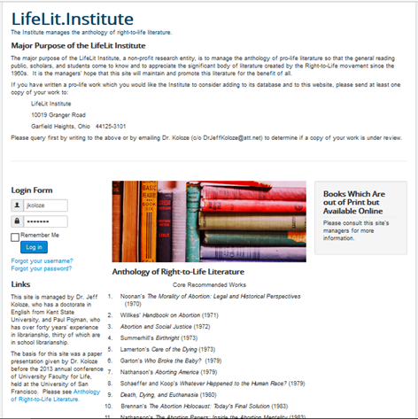
Lifelit Institute

Slide 12
Future Activity and Projects
Further site construction
Ongoing site maintenance
Adding more titles
Finding qualified writers to review the works
If permission can be obtained from the Sisters for Life, add the holdings of the Dr. Joseph R. Stanton Human Life Issues Library and Resource Center
Adding holdings from other pro-life groups
Determining how the site can assist pro-lifers
Other projects as site is publicized

Slide 13
Purposes of LifeLit Institute
The major purpose of the LifeLit Institute, a non-profit research entity, is to manage the anthology of pro-life literature so that the general reading public, scholars, and students come to know and to appreciate the significant body of literature created by the Right-to-Life movement since the 1960s. It is the managers' hope that this site will maintain and promote this literature for the benefit of all.

Slide 14
Comments
Questions
Suggestions

